Slide 1
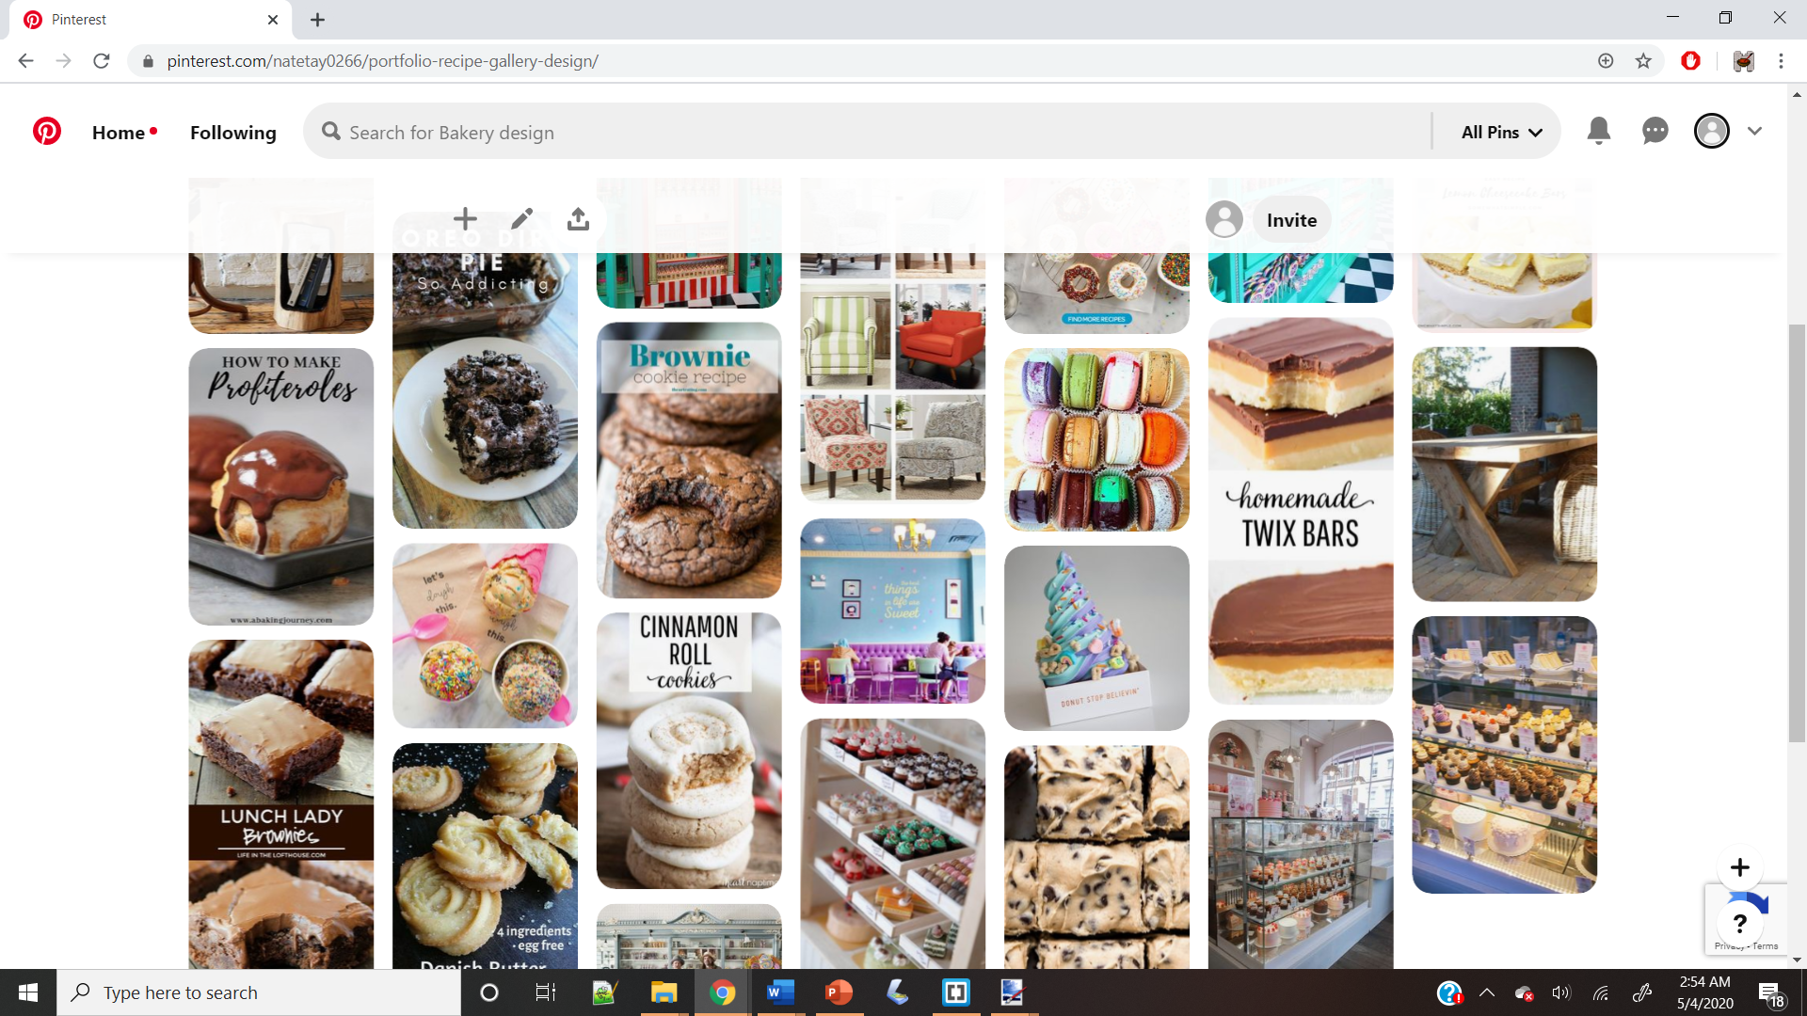
https://www.pinterest.com/natetay0266/portfolio-recipe-gallery-design/

Slide 2
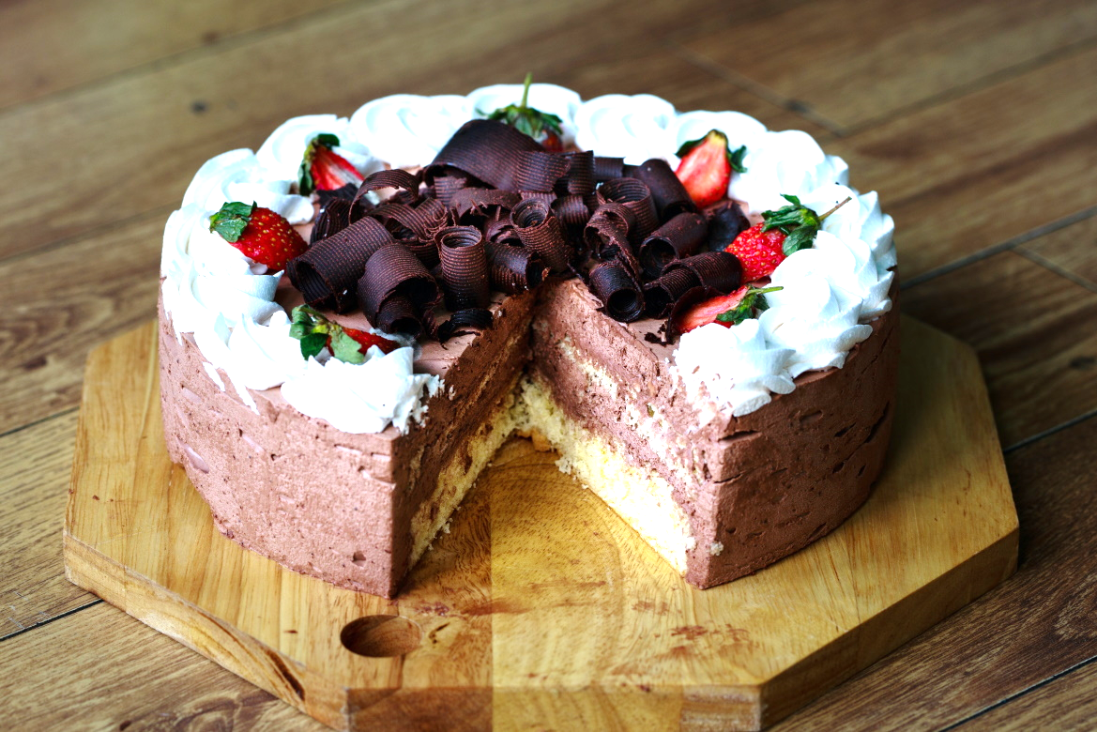
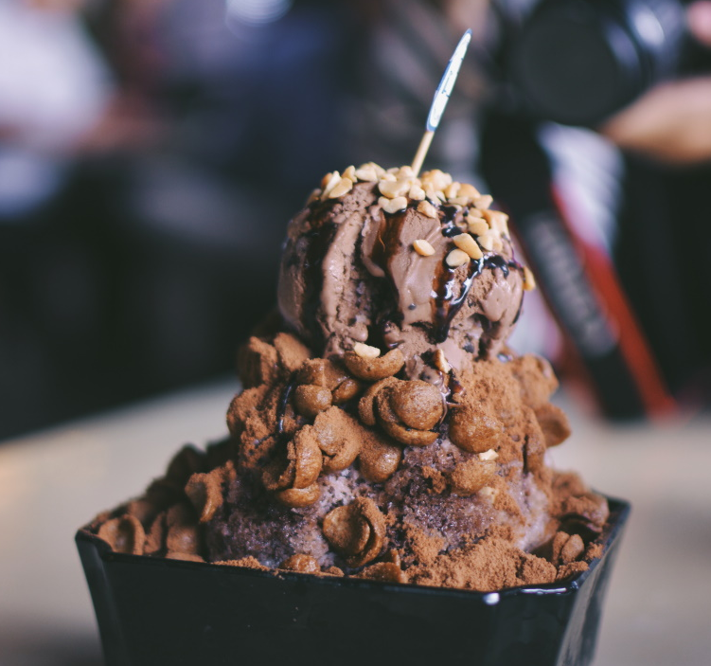
Keys: Serif
Title Name
Prep Time: 5 min
Regular Headings: Serif
Body and other copy: Serif
Mobile Style Tiles

Slide 3
Keys: Serif
Regular Headings: Serif
Body and other copy: Serif
Tablet Style Tiles
Title Name
Full Recipe
Prep Time: 5 min

Slide 4
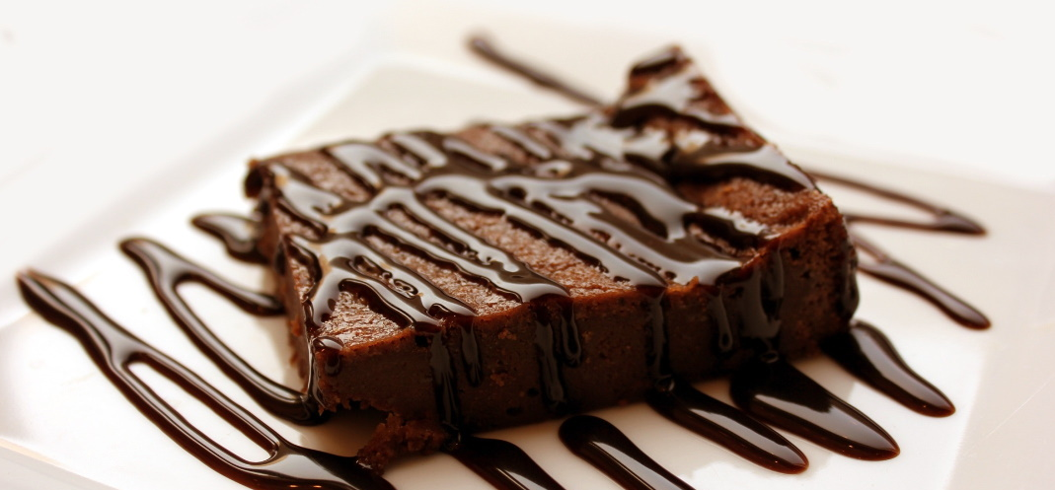
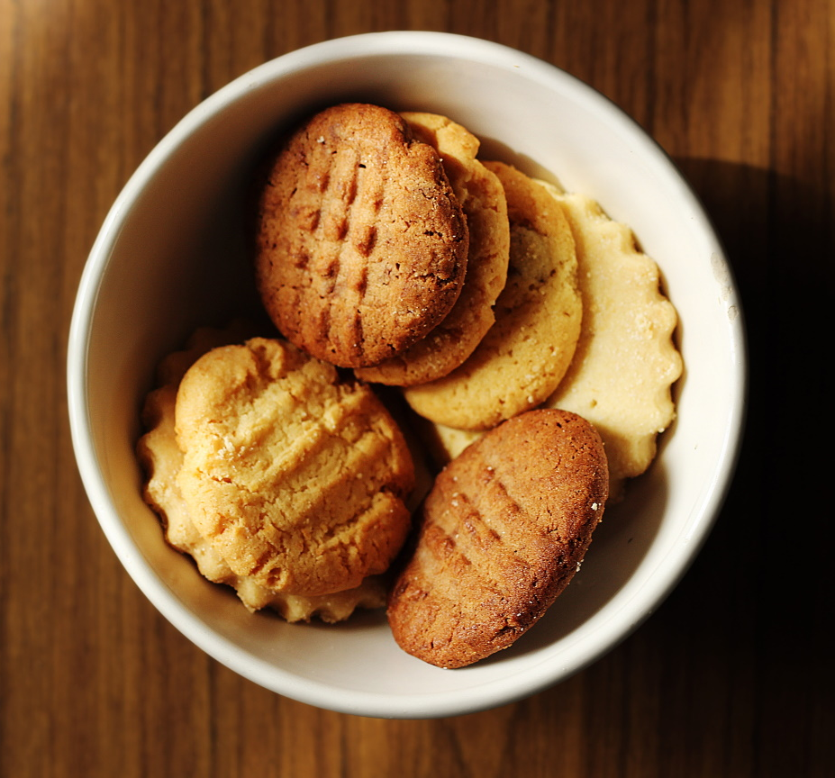
Title Name
Prep Time: 5 min
Keys: Serif
Regular Headings: Serif
Body and other copy: Serif
Desktop Style Tiles

Slide 5
Title Name
Title Name
Prep Time: 5 min
Ingredients
Prep Time: 5 min
Magic
Fluff
Cotton Candy
Pixie Dust
Full Recipe
Keys: Serif
Regular Headings: Serif
Body and other copy: Serif
Desktop Style Tiles

